Slide 1
INTRO 2 SOUND RECOGNITION
Amit Weiss – 3.4.19

Slide 2
What We Have For Today
Sound Recognition - Why
What is Sound
Physics
Fourier Transform
Nature of Sound Sources
Sound Signal
Sampling
Aliasing
DFT
Feature Extraction
MFCCs
Filter banks
Other features

Slide 3
WHY?

Slide 4

Second Nature For Humans

Slide 5
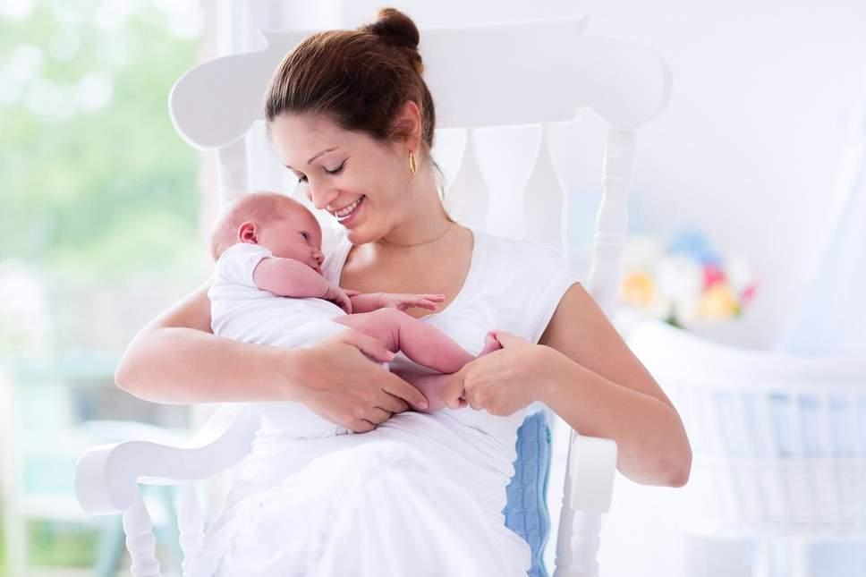
Second Nature For Humans

Slide 6
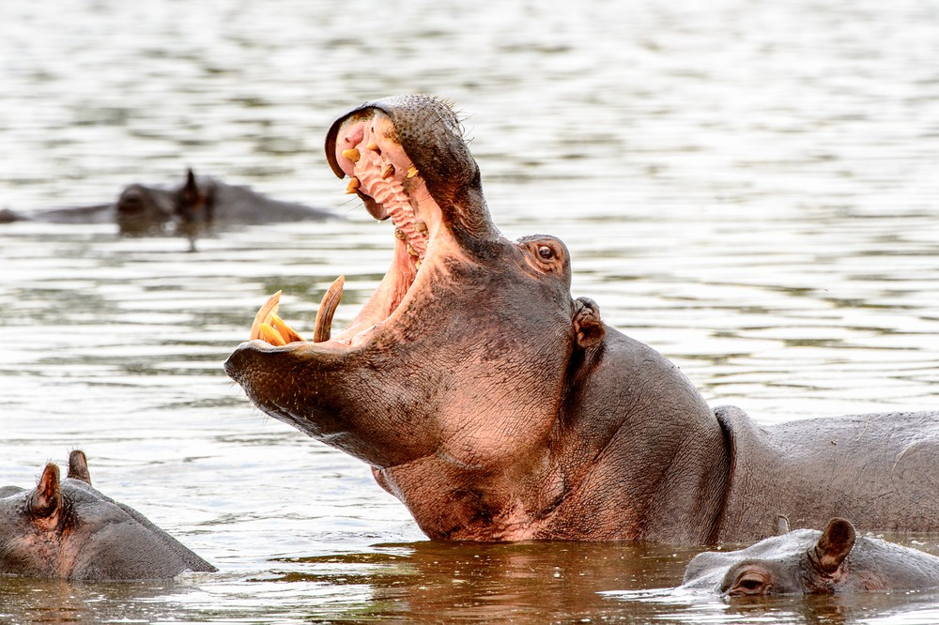
Second Nature For Humans

Slide 7
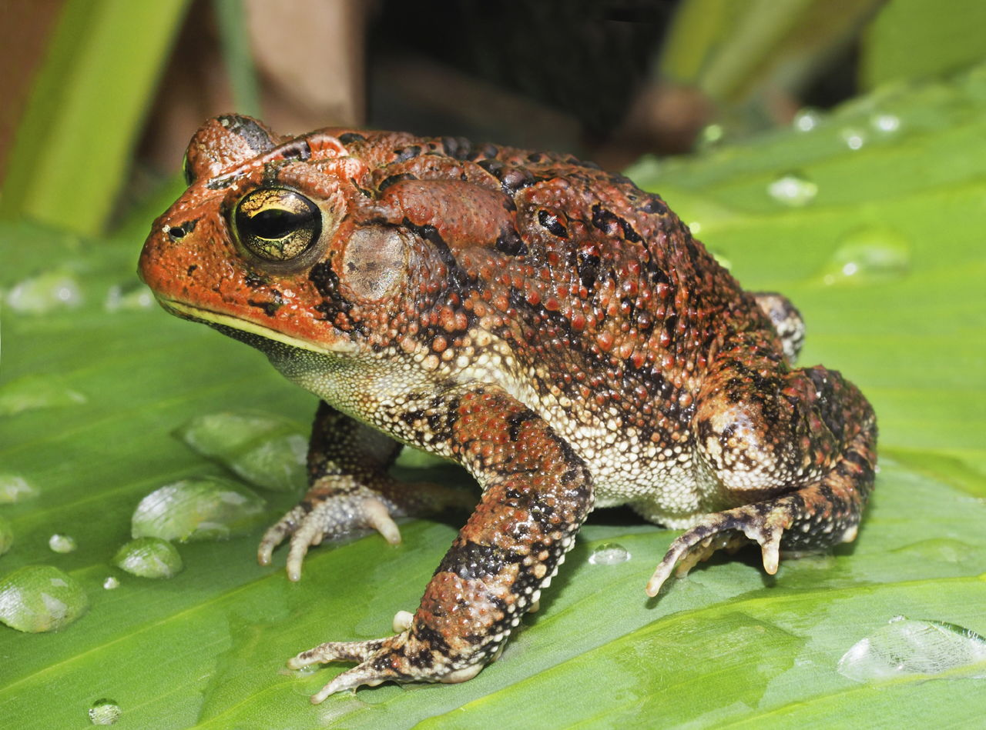
Second Nature For Humans

Slide 8

Second Nature For Humans

Slide 9
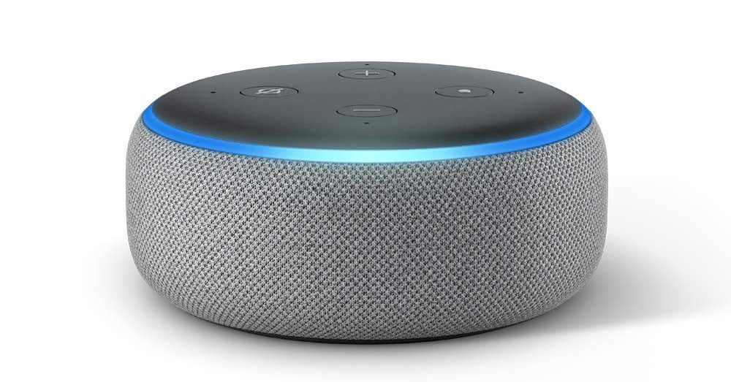
Second Nature For Humans

Slide 10
SOUND

Slide 11
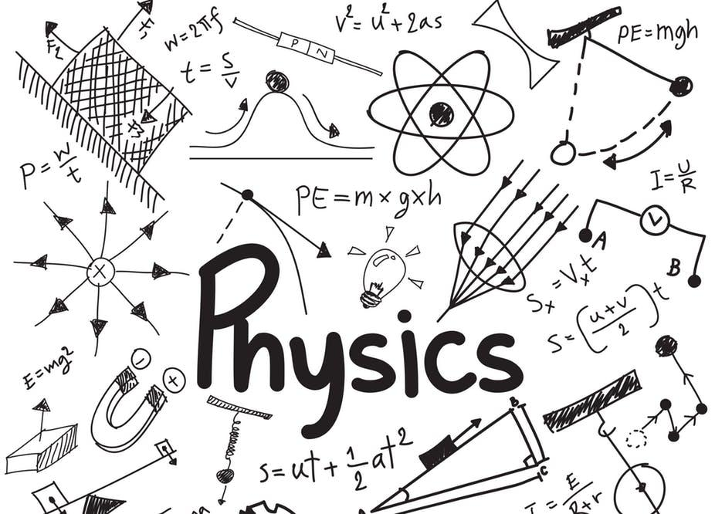

Slide 12
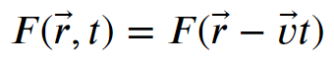
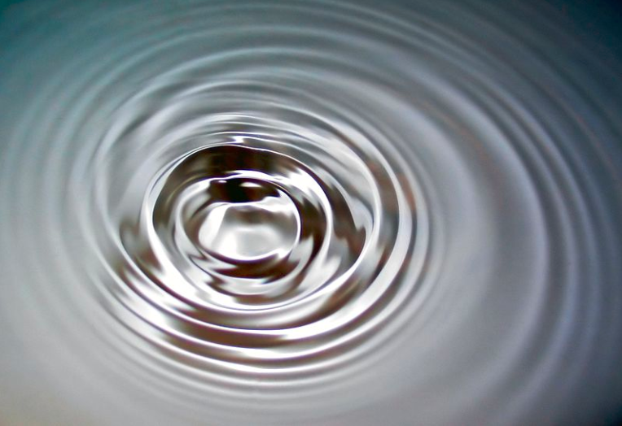
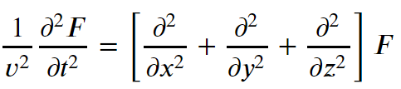
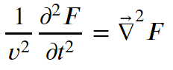
Sound Waves
Are Waves..

Slide 13

Sound Waves
Transverse Waves

Slide 14
Sound Waves
Transverse Waves

Slide 15

Sound Waves
Longitudinal Waves

Slide 16
Sound Waves
Longitudinal Waves

Slide 17
Sound Waves

Slide 18
Sound Waves

Slide 19
Sound Waves

Slide 20
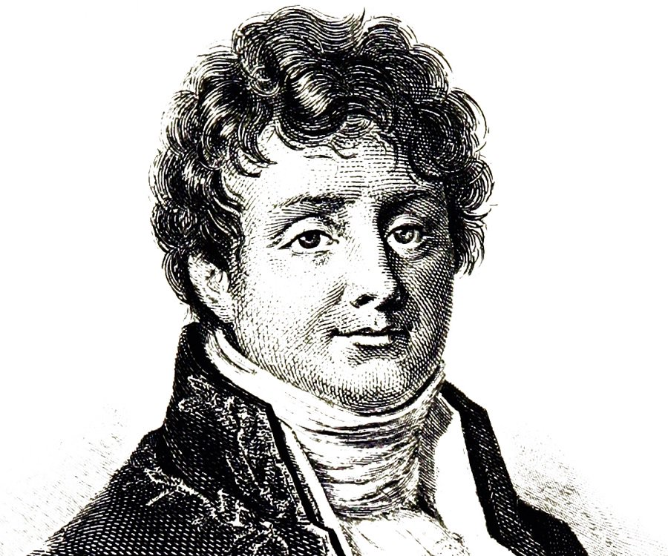

Slide 21
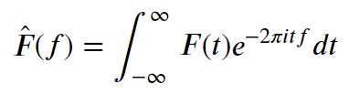
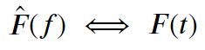
Fourier

Slide 22
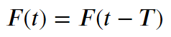
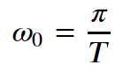
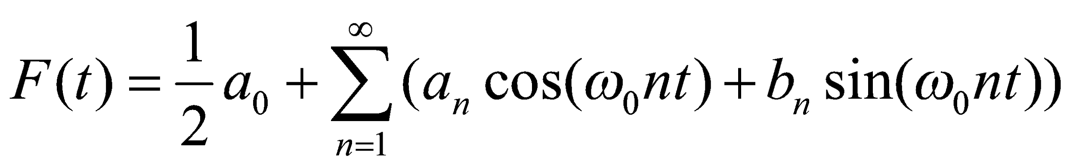
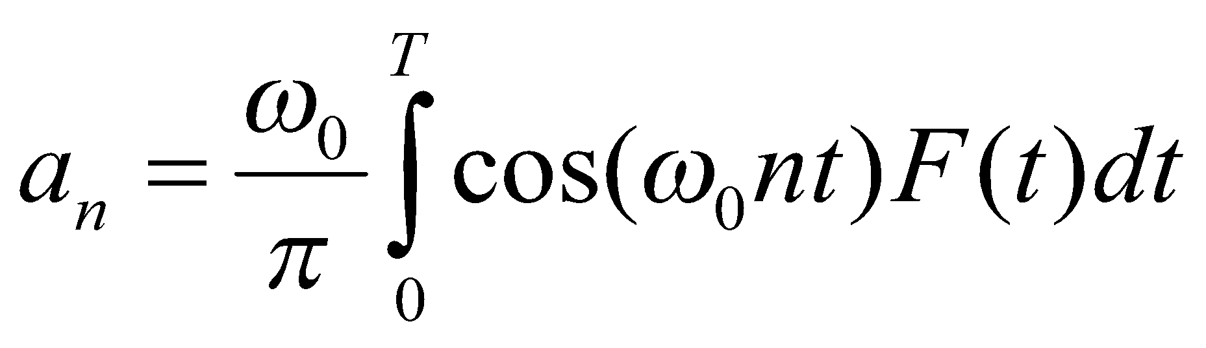
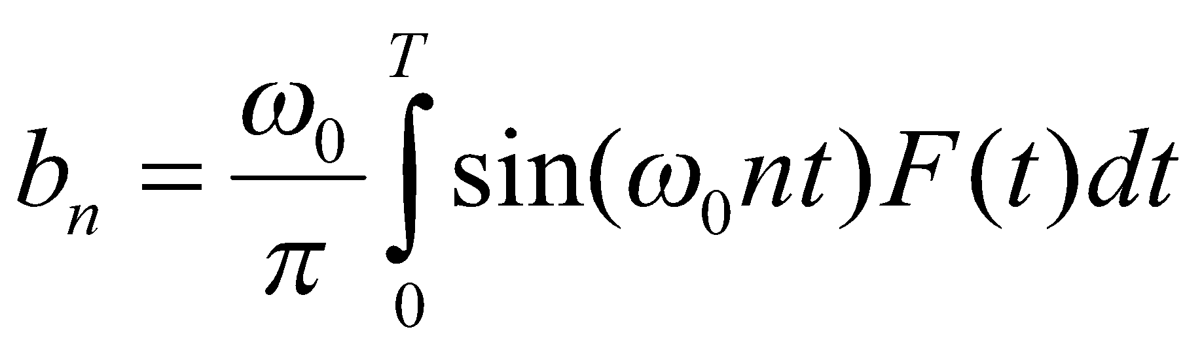
Fourier
Periodic functions:

Slide 23
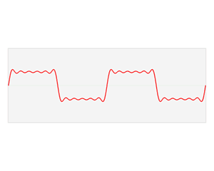
Fourier

Slide 24
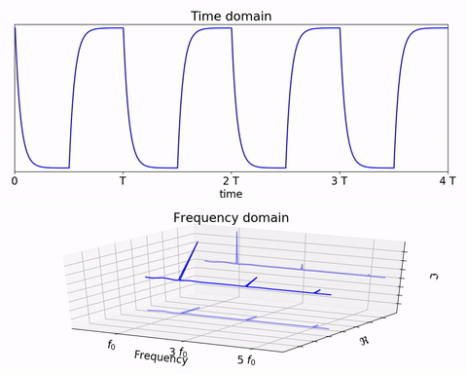
Fourier

Slide 25
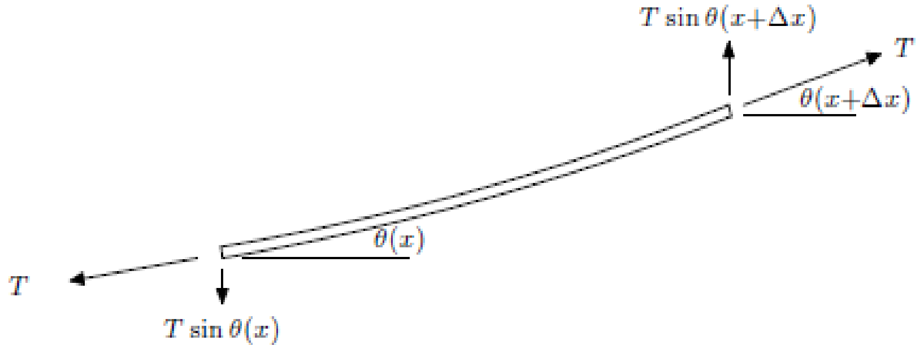

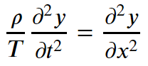
Sound Nature

Slide 26
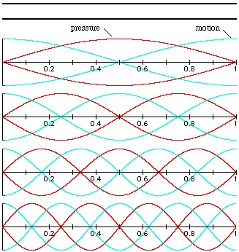
Sound Nature

Slide 27
Sound Nature

Slide 28
SOUND SIGNAL

Slide 29
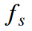
Sampling
Sampling rate
Bit depth – Controls most of the SNR
DATA
Sampling rate of 44.1 [KHz]
16-bit Resolution
2 channels for Stereo
88,200 integers per second

Slide 30
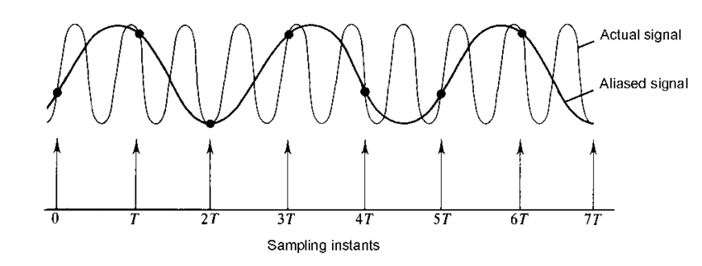
Sampling
Aliasing !!

Slide 31
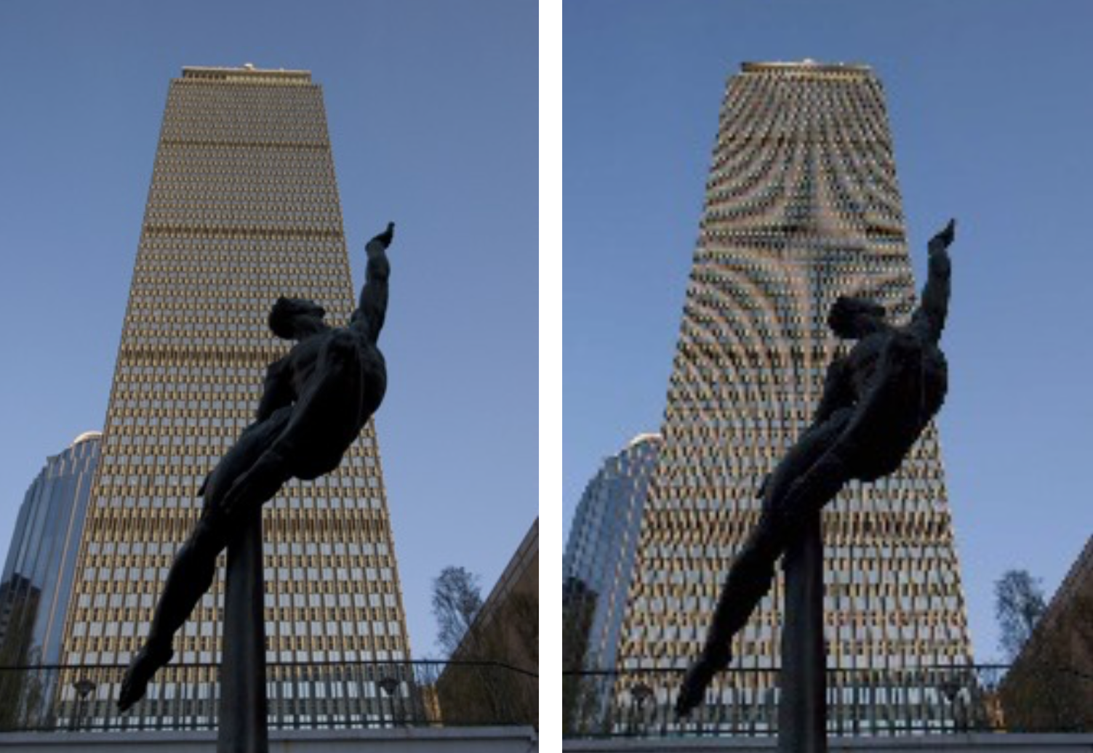
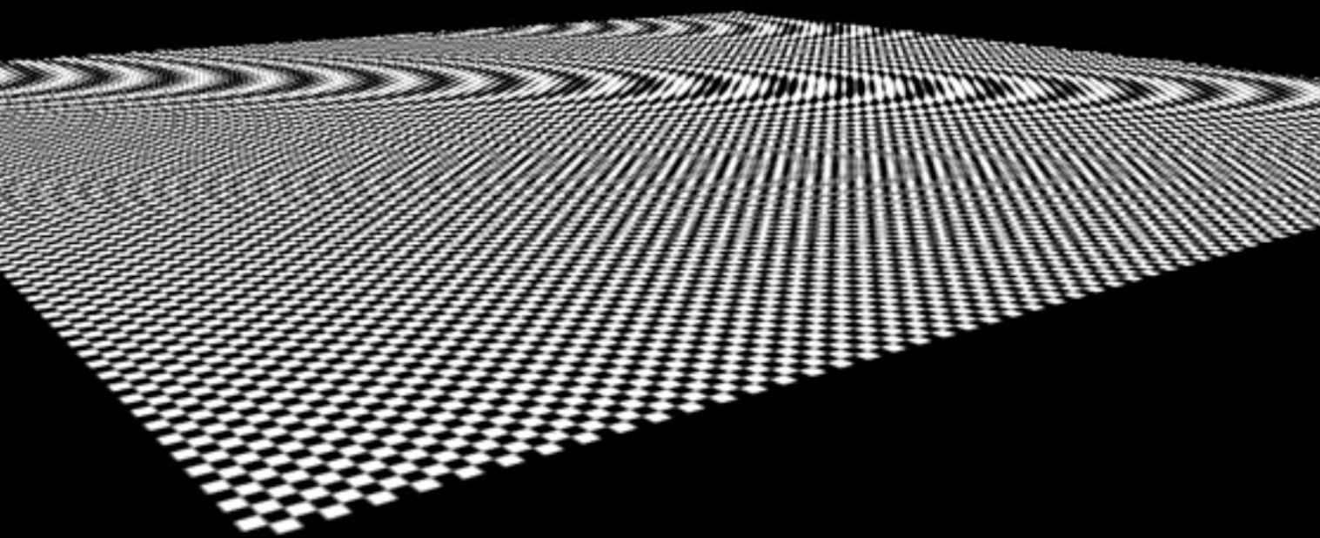
Sampling

Slide 32
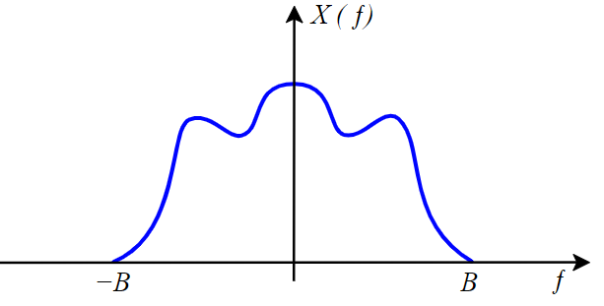
Sampling
Sampled data CAN be Fully recoverd Sometimes
Imagine a Low Freq Signal:

Slide 33
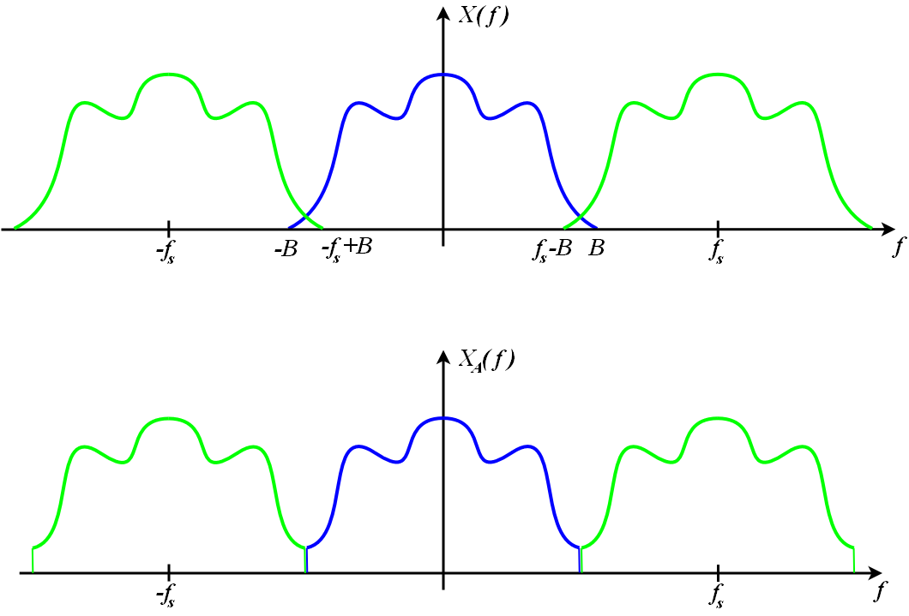
Sampling

Slide 34
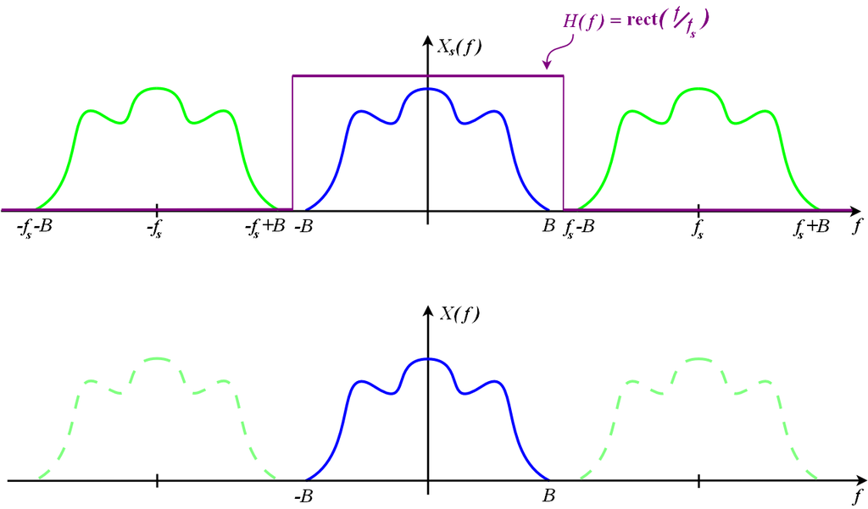
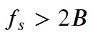
Nyquist Theorem

Slide 35
Relevant Frequencies
Humens can hear : 20[Hz] – 20,000 [Hz]
Sampled – 44.1 ~ 48 [KHz]
Humens Speak at: 100[Hz] – 4,000[Hz]
Sampled – 8 [KHz]

Slide 36
The World Of Acronyms
FT – Fourier Transform
DTFT – Discrete Time Fourier Transform
DFT – Discrete Fourier Transform
FFT – Fast Fourier Transform
STDFT – Short Time Discreate Fourier Transform

Slide 37
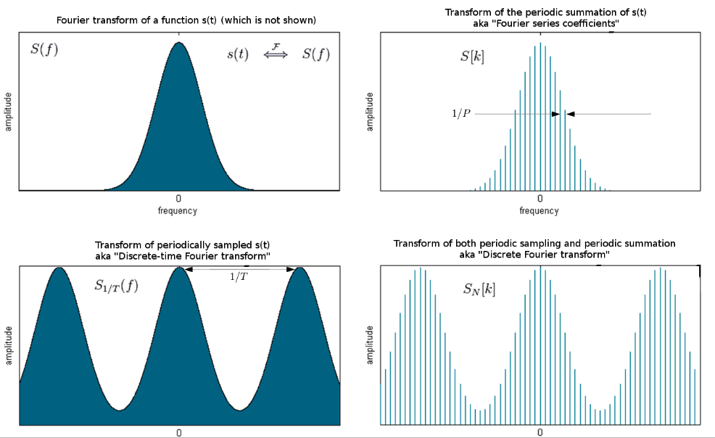
FT
DTFT
DFT

Slide 38
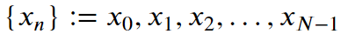
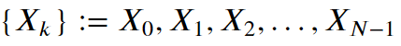
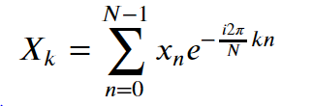
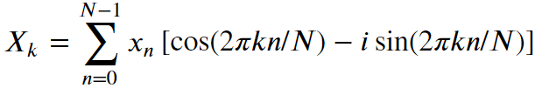
DFT

Slide 39
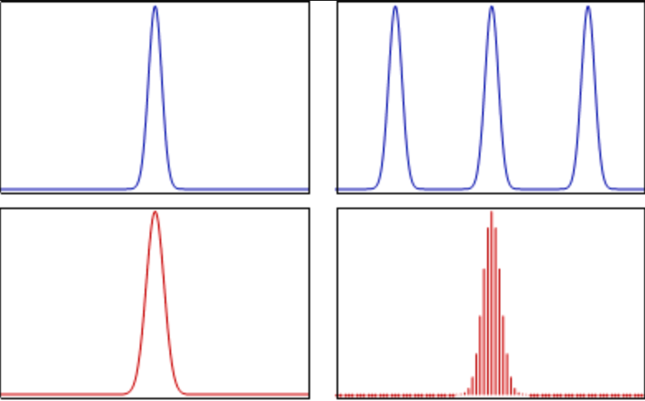
DFT

Slide 40
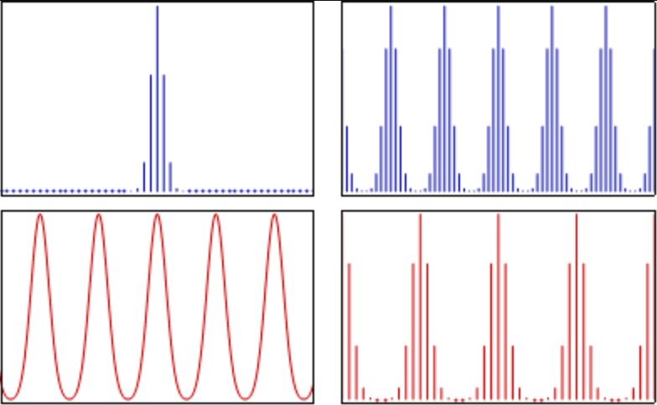
DFT

Slide 41
FEATURE EXTRACTION

Slide 42
Common Features
Spectral Features
Spectral Centroid
Spectral Rolloff
Chroma Frequencies
GammaTone Log Energies
Filter Banks
MFCCs
Power related Features
Zero Crossing Rate (ZCR)

Slide 43
Common Features
Spectral Features
Spectral Centroid
Spectral Rolloff
Chroma Frequencies
GammaTone Log Energies
Filter Banks
MFCCs
Power related Features
Zero Crossing Rate (ZCR)

Slide 44
Mimicking the Ear
Our Ears perform Quasi-Stationary Frequency analysis
Our Ears volume sensitivity depends upon frequency
Our Ears frequency scale is nonlinear

Slide 45
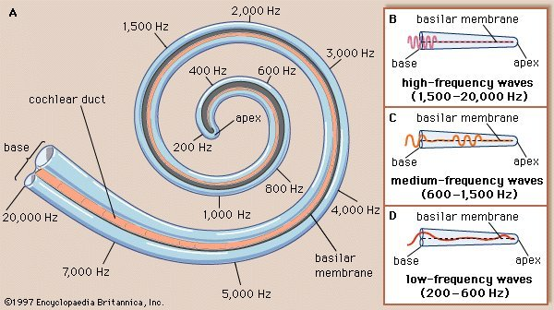
The Cochlea

Slide 46
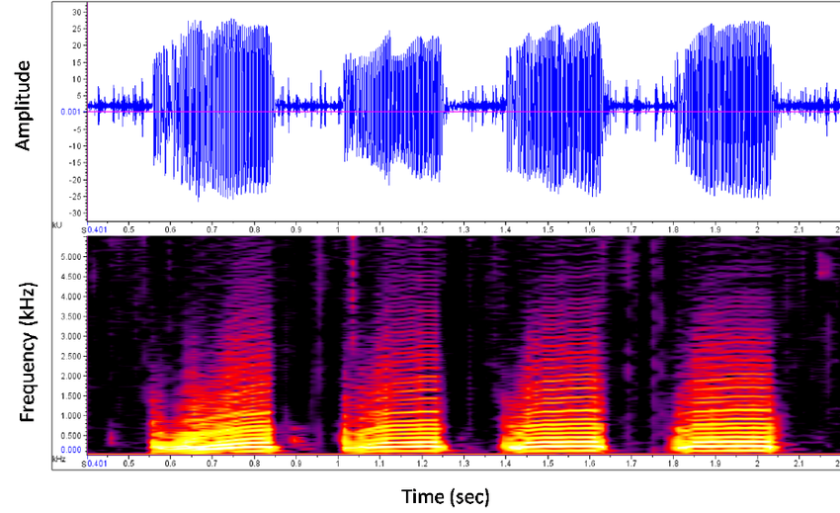
Spectrogram

Slide 47
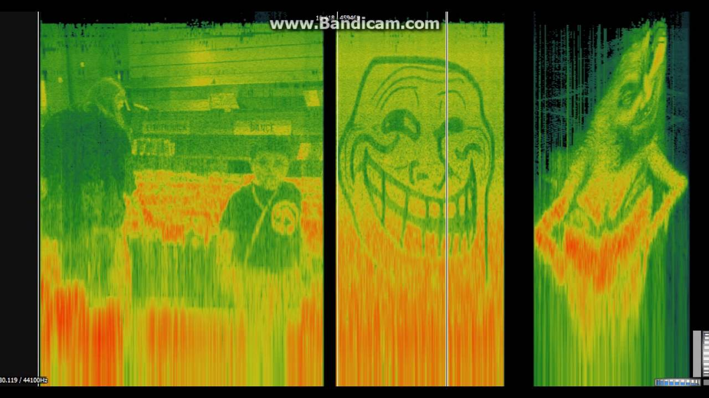
Spectrogram
10~40 [ms] of a window for speech

Slide 48
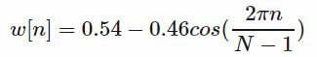
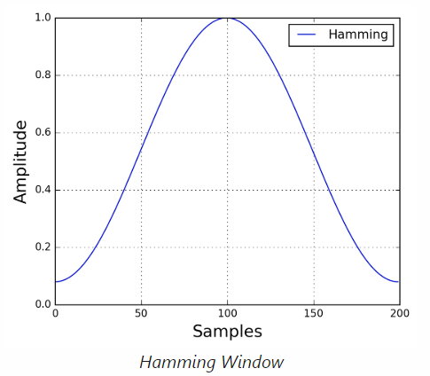
Hamming Window

Slide 49
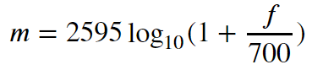
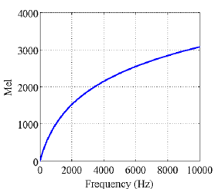
Mel Scale

Slide 50
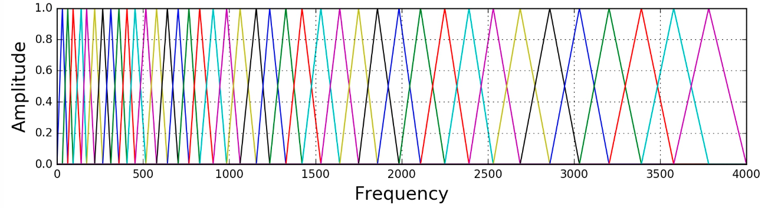
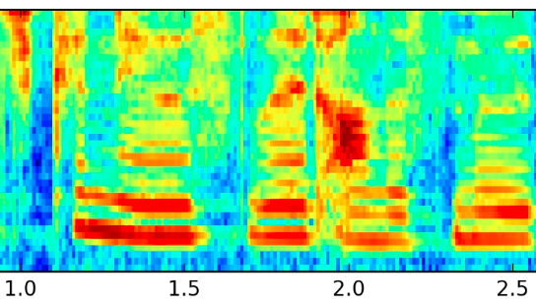
Filter banks

Slide 51

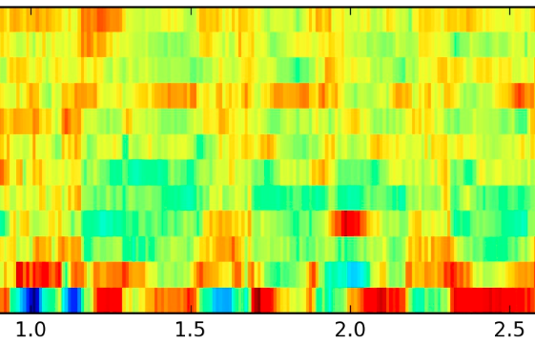
MFCCs
Calculate the Spectrogram
Apply Mel Filters on the Spectrogram
Derive the DCT on each spectral time frame
Take the lowest 12 values

Slide 52


